Slide 1
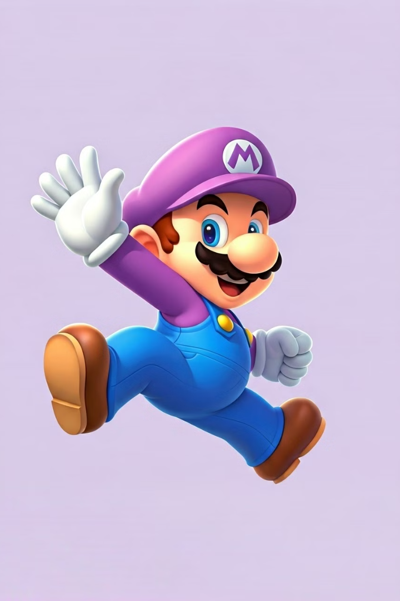
Deployment of Super Mario on Kubernetes using Terraform
Explore the journey of deploying the beloved Super Mario game on Kubernetes using Terraform and AWS infrastructure.

Slide 2

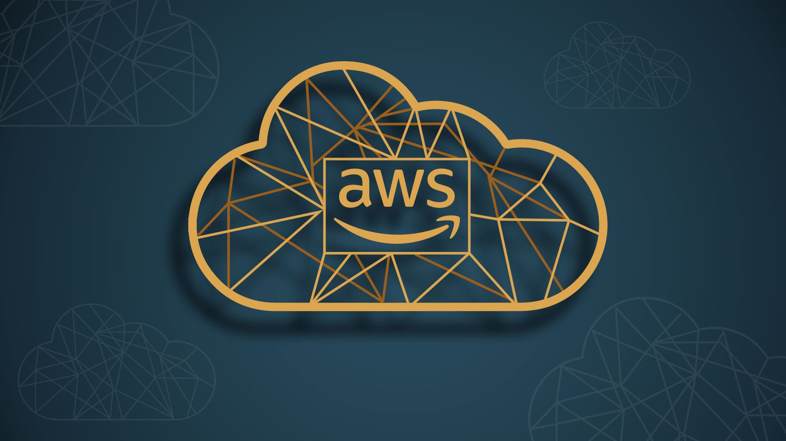
Prerequisites
1
AWS Account
2
Basics Knowledge
3
IAM Role
An AWS account is required to provision the necessary resources.
Familiarity with AWS, Terraform, Jenkins ,and Kubernetes is recommended.
An IAM role with the necessary permissions must be set up for the EC2 instance.

Slide 3
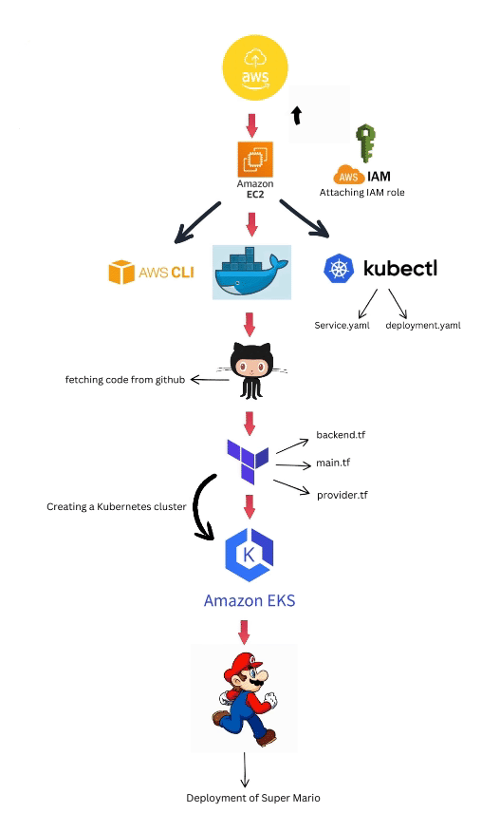
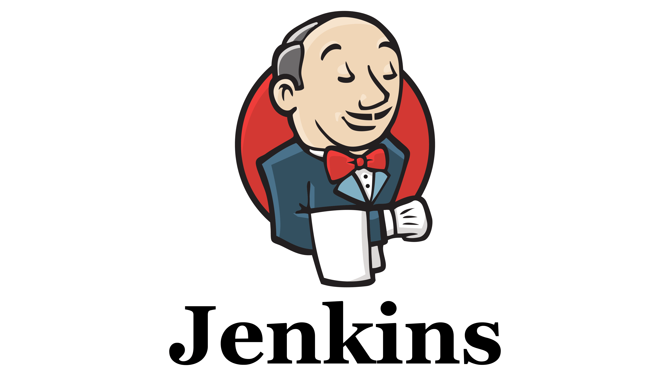
Deployment Steps
1
Setup
Configure Terraform, AWS CLI, and Kubectl on an EC2 instance.
2
IAM Role
Create an IAM role with the necessary permissions for the EC2 instance.
3
Infrastructure And CI/CD
Use Terraform to build the infrastructure and Jenkins To Build CI/CD , including the EKS cluster.

Slide 4
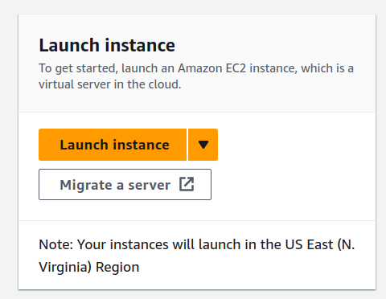
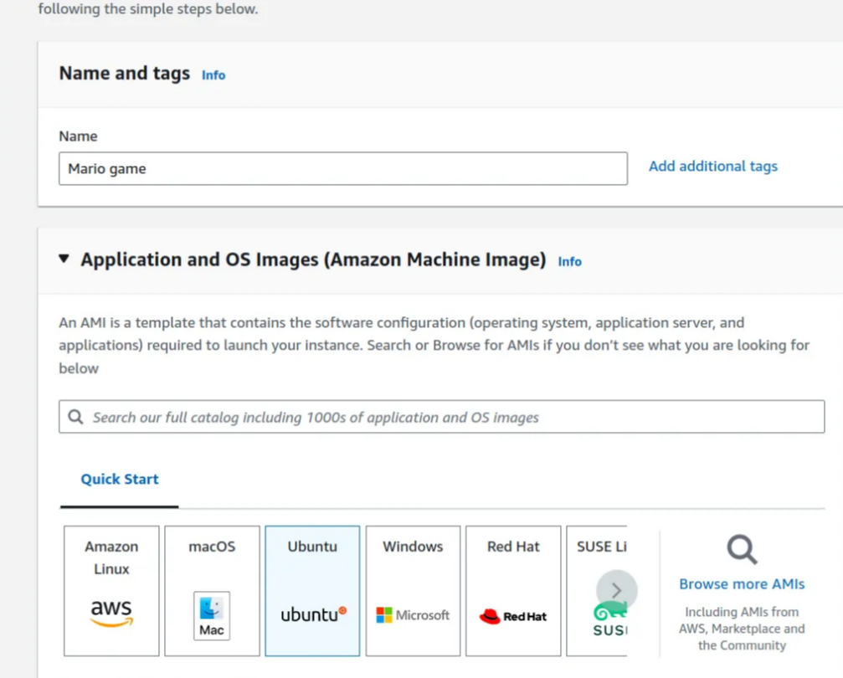
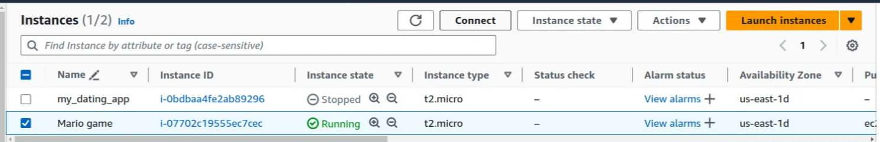
1
Setup
Launch EC2 Instance

Slide 5
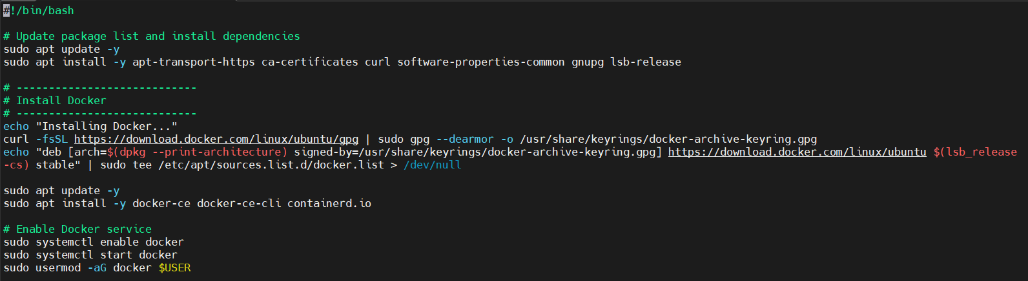
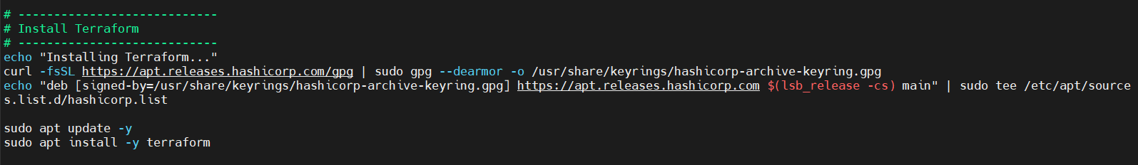
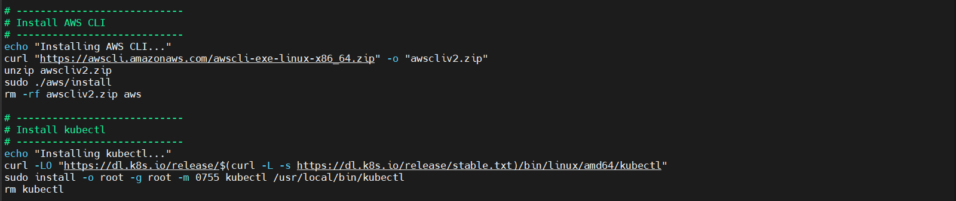
Install and Configure Docker Terraform, AWS CLI, and Kubectl on an EC2 instance Using Bash Script.

Slide 6
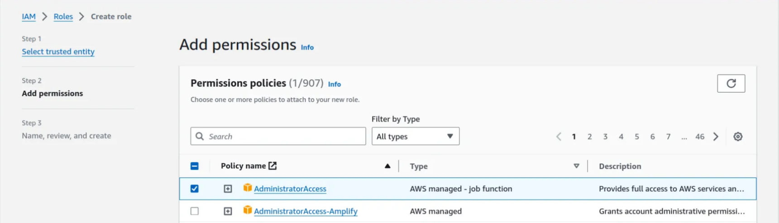
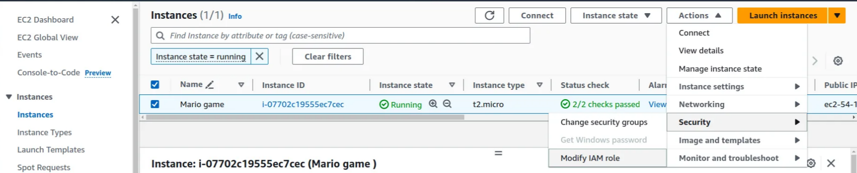
2
IAM Role
Create an IAM role with the necessary permissions for the EC2 instance.

Slide 7
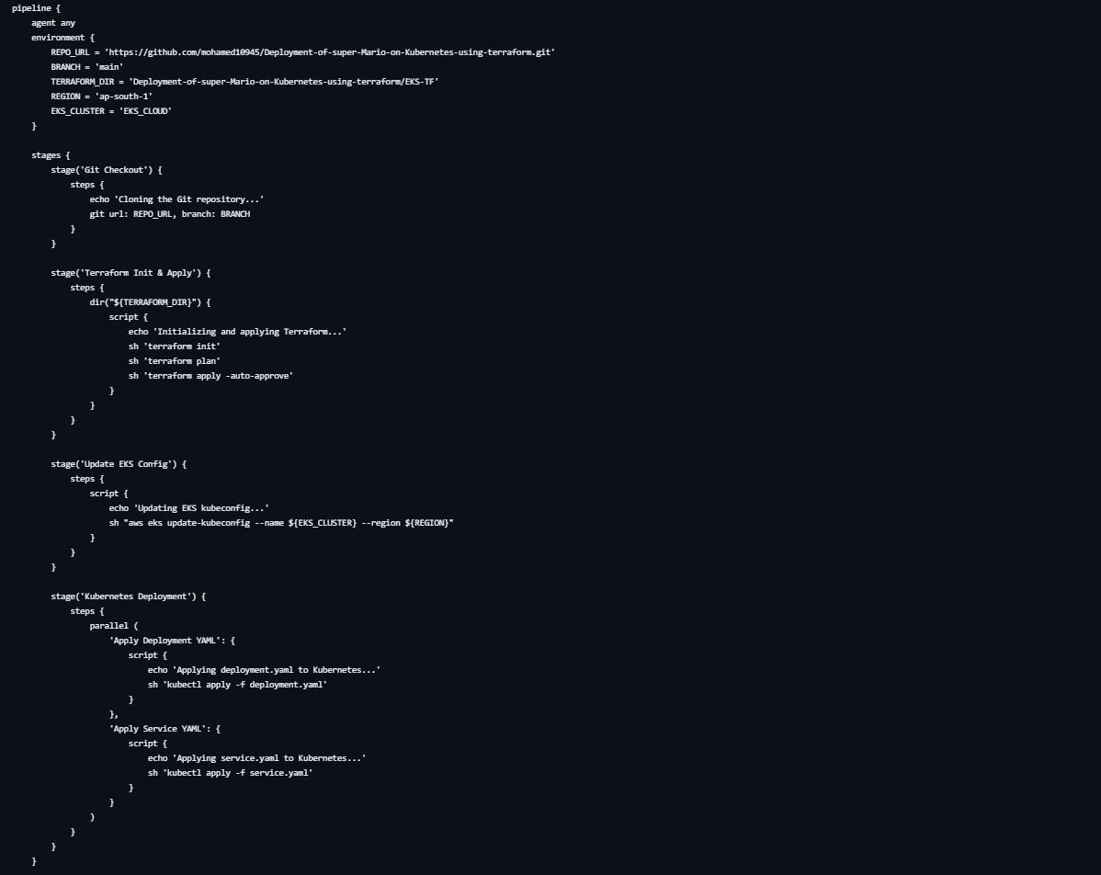
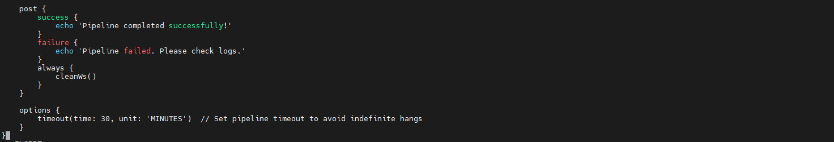
3
CI/CD - Jenkins
1
Jenkins Pipeline

Slide 8
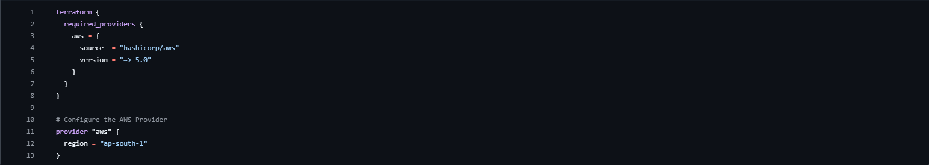
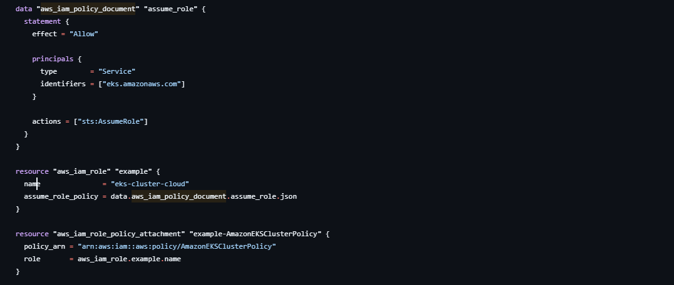
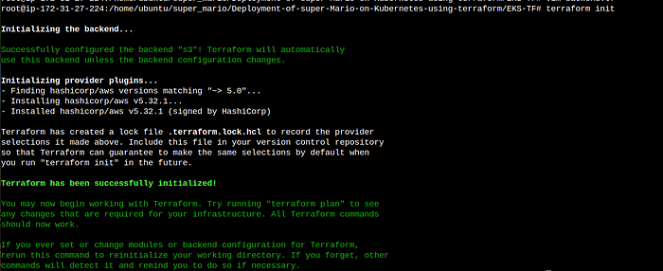
Use Terraform to build the infrastructure, including the EKS cluster.
1
Provider.tf
2
Main.tf
3
backend.tf
4
Terraform init Terraform apply

Slide 9
Kubernetes Deployment
Deployment
Service
Verification
Create a Kubernetes deployment for the Super Mario application.
Set up a Kubernetes service to expose the application to the internet.
Verify the deployment and service by accessing the application's URL.

Slide 10
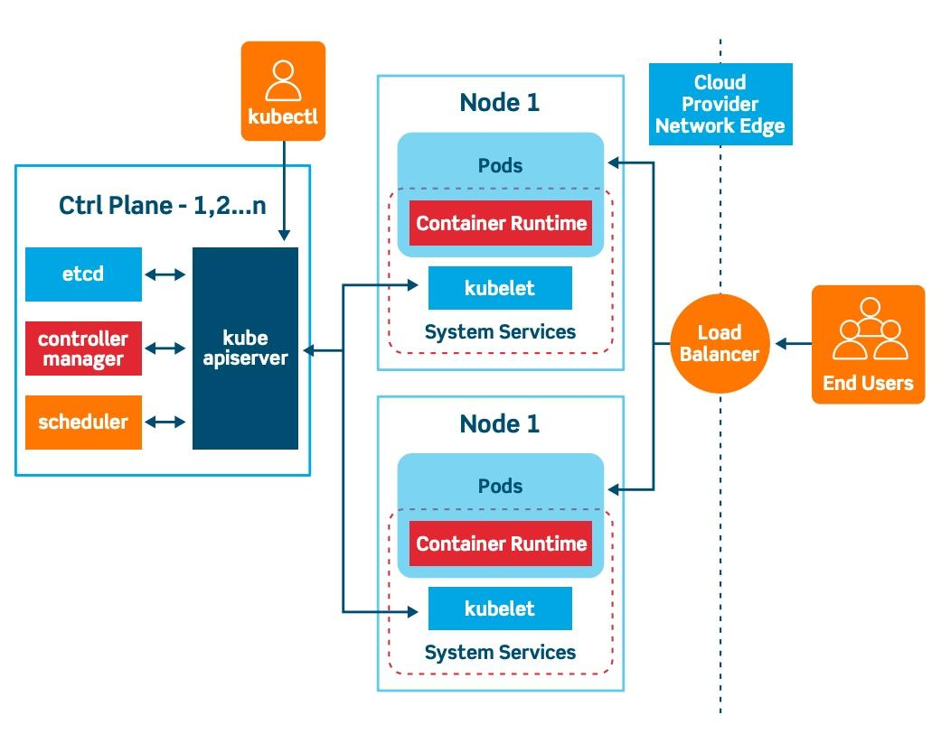

Slide 11
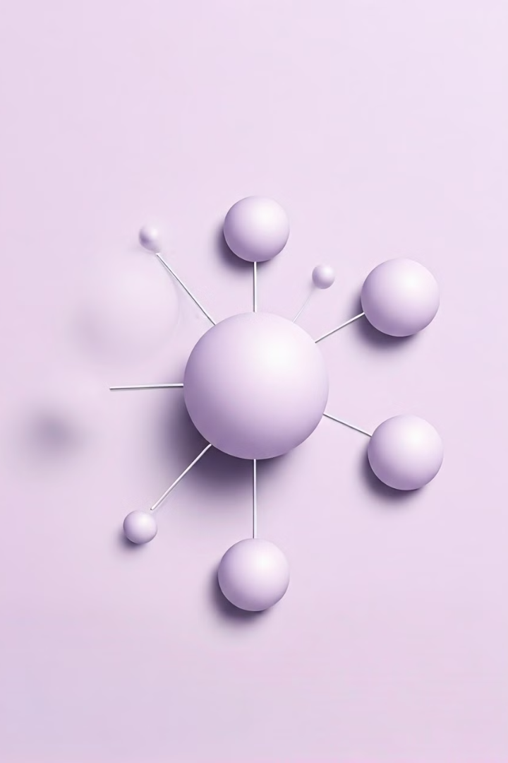
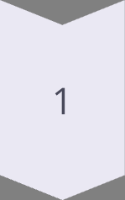
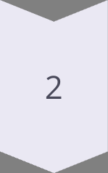
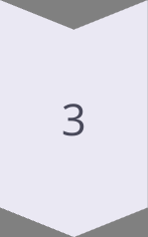
Benefits of Kubernetes
Scalability
Kubernetes can easily scale the Super Mario application to handle increased traffic.
Reliability
Kubernetes ensures the application remains highly available and fault-tolerant.
Automation
Terraform automates the infrastructure provisioning, making deployments efficient.

Slide 12
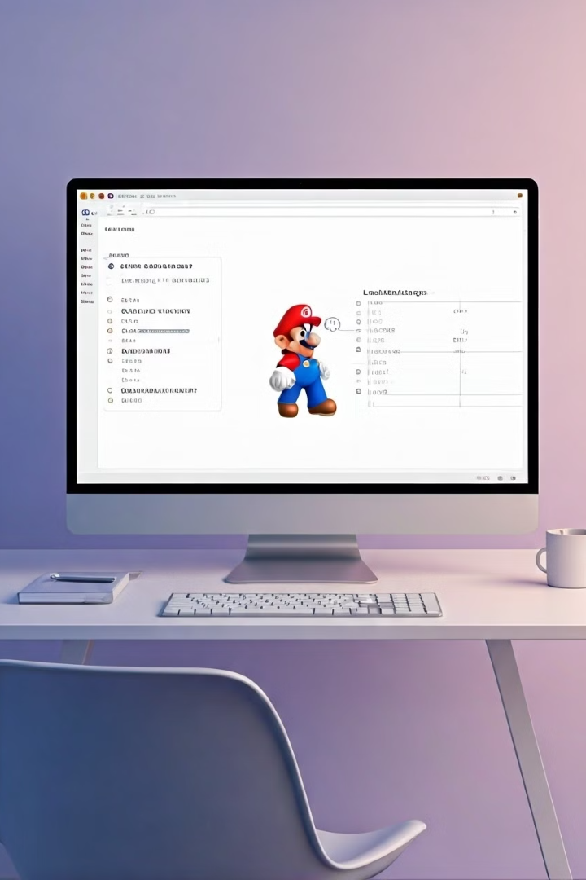



Load Balancer Ingress
Load Balancing
The Kubernetes service creates a load balancer to distribute traffic.
Ingress
The load balancer ingress provides the URL to access the Super Mario application.
Access
Copy the load balancer ingress and paste it into a web browser to play Super Mario.

Slide 13
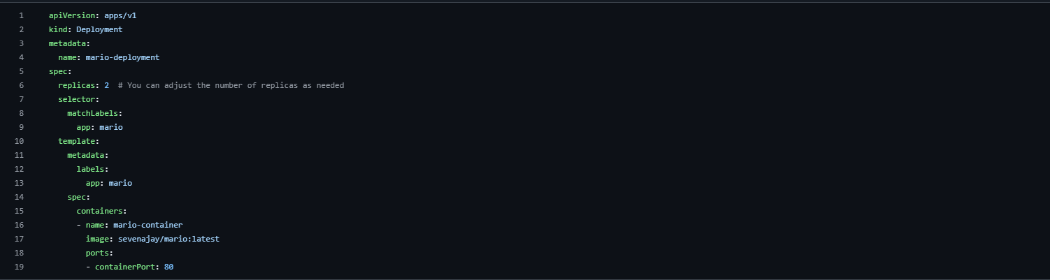
Deployment
Create a Kubernetes deployment for the Super Mario application.

Slide 14
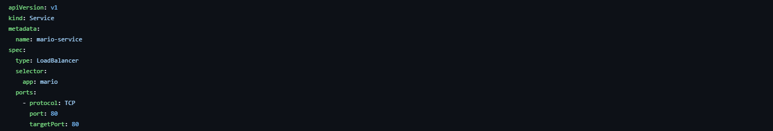
Service
Set up a Kubernetes service to expose the application to the internet.

Slide 15
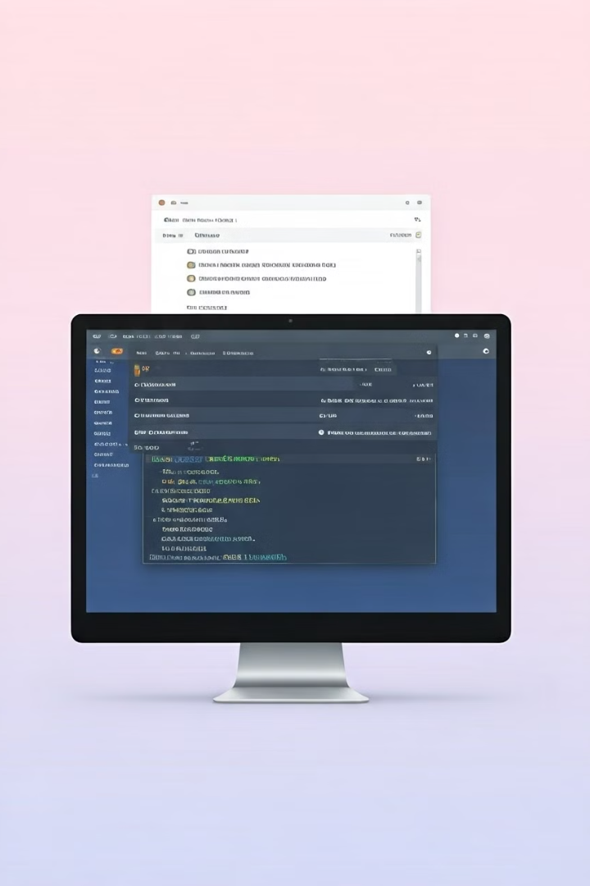
Infrastructure Cleanup
Deployment Deletion
EKS Destruction
Remove the Kubernetes deployment and service for the Super Mario application.
Use Terraform to destroy the EKS cluster and associated infrastructure.
EC2 Termination
Terminate the EC2 instance used for the deployment process.

Slide 16
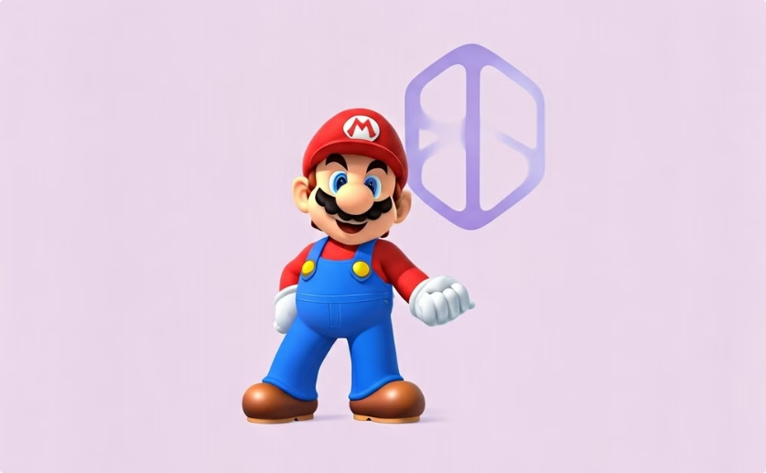

Conclusion
Successful Deployment
Teamwork and Collaboration
The Super Mario game is now successfully deployed on Kubernetes using Terraform.
The deployment process showcases the power of teamwork and collaboration.
Explore the endless possibilities of containerizing and orchestrating your favorite games with Kubernetes and Terraform.

